Slide 1
NYS AHPERD ANNUAL CONF @80
CONSENT CULTURE FOR REAL LIFE
KAREN B. K. CHAN

Slide 2
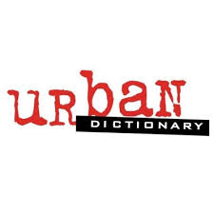
A consent culture is one in which the prevailing narrative of sex is centered around mutual consent. It is a culture with an abhorrence of forcing anyone into anything, a respect for the absolute necessity of bodily autonomy, a culture that believes that a person is always the best judge of their own wants and needs.
A consent culture is also one in which mutual consent is part of social life as well. Don't want to talk to someone? You don't have to. Don't want a hug? That's okay, no hug then. Don't want to try the fish? That's fine. Don't want to be tickled or noogied? Then it's not funny to chase you down and do it anyway.
CONSENT CULTURE

Slide 3
PLEASURE
DESIRE
Feels good
I want
CONSENT
AROUSAL
I decide
Physical response

Slide 4
THERE IS
THERE IS
THERE IS
DESIRE
PLEASURE
PLEASURE
CONSENT
I want
AROUSAL
Feels good
Feels good
I decide
Physical response
BUT NO
AROUSAL
CONSENT
BUT NO
BUT NO
Physical response
I decide
CONSENT
I decide

Slide 5
CONSENT
Why is it hard to say yes?
Why is it hard to “say no?
Why is it hard to ask for consent?

Slide 6
REJECTION
Seeking consent = possible rejection
Like physical pain
What does can’t take rejection mean?
Sexual realms represent self worth
How do we have a healthy relationship to the pain of rejection?
What is masculinity’s relationship to pain?

Slide 7
To hell with them. Nothing hurts if you don’t let it.

Slide 8
ATTACK SELF
ATTACK OTHERS
FIGHT
ZONES
COMFORT
STRETCH
FLIGHT
PANIC
WITHDRAW
AVOID

Slide 9
ATTACK SELF
ATTACK OTHERS
FIGHT
ZONES
COMFORT
STRETCH
FLIGHT
PANIC
WITHDRAW
AVOID

Slide 10
REJECTION SKILLS 1
Recognize it
Name it
Feel it
Bear it - resilience
Expect it
Reframe failure - it means X, not Y
Care for it
Exit plan

Slide 11
REJECTION SKILLS 2
Recognize courage
Permission for fear, hurt, not feeling ready
Counter feel-good culture
Normalize the actual feeling of rejection
Keep going”

Slide 12
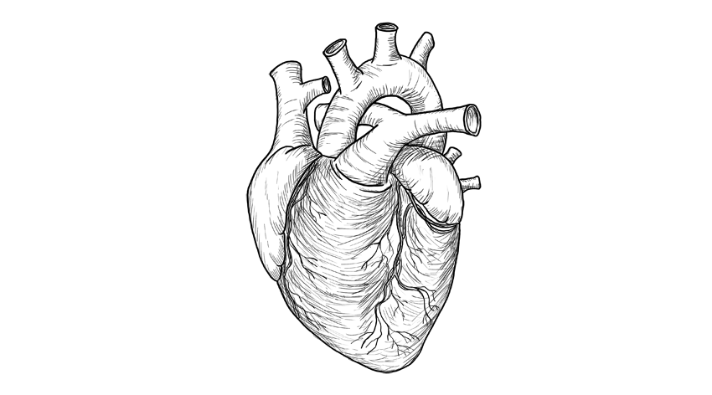
May our choices
reflect our hopes,
not our fears.
~Nelson Mandela
Karen B. K. Chan

